Slide 1

STOCK BOT – A MATHEMATICAL STOCK RECOMMENDATION PROGRAM
PROBLEM STATEMENT:
Algorithmic trading makes use of complex formulas, combined with mathematical models and human oversight, to make decisions to buy or sell financial securities on an exchange.
Build a Stock Bot. A Stock Bot is an Automated System which mathematically analyses stock information in order to make decisions regarding buying and selling certain stocks.
Algorithms used – Probability Normal Distribution, Simple Moving Average Strategy, Best Months to Invest in strategy & Sentiment Analysis.
Test Stocks – AAPL, AMZN, FB, NFLX, GOOG
DATA ANALYTICS AGENT FOR STOCK ANALYSIS

Slide 2

STOCK BOT – A MATHEMATICAL STOCK RECOMMENDATION PROGRAM
OBJECTIVE:
The Stock Bot program will analyze past closing prices of given stocks and will use concepts of percent change, probability & normal distribution to predict whether a stock is more likely to rise or fall. This will be customized to users initial investment, target price & duration of investment based on which the Stock Bot will determine the risk the user is willing to take for the investment. Furthermore the Stock Bot will make use of Simple Moving Average Algorithm for a moving time period and will also determine which are the best months to invest in given stocks. This way the stock bot tells you which stock has greatest probability to rise from given stocks, when a user must buy and sell it and in which month the user would gain maximum profit.

Slide 3
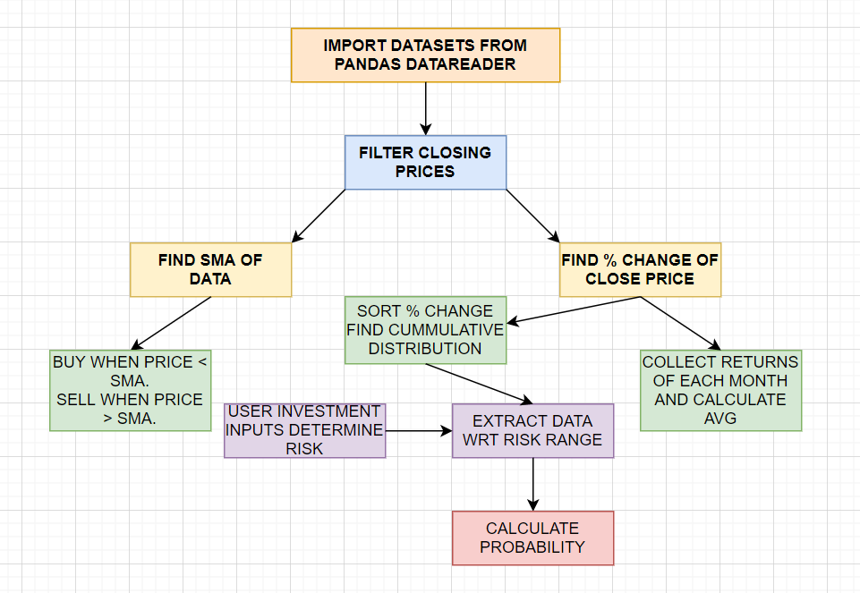
STOCK BOT – A MATHEMATICAL STOCK RECOMMENDATION PROGRAM
DESIGN AND ARCHITECTURE:

Slide 4
STOCK BOT – A MATHEMATICAL STOCK RECOMMENDATION PROGRAM
TECHNIQUES:
PROBABILITY AND NORMAL DISTRIBUTION – Based on past data analysis the Stock Bot sorts the day wise % change. Cumulative probability is then assigned to the set of values of % change. Based on risk percentage. Probability of certain range of change occurring as per users requirement is calculated. Stocks then can be compared for highest probability being the safest investment option.
SIMPLE MOVING AVERAGE STRATEGY - The Simple Moving Average (SMA) is calculated by adding the price of an Stock over a number of time periods and then dividing the sum by the number of time periods. The SMA is basically the average price of the given time period, with equal weighting given to the price of each period. This will help indicate when to buy / sell a stock putting markers on a graph.
BEST MONTHS TO INVEST IN STRATEGY – Collect returns on all the months over the day wise % change of the past data collected in lists. Take averages of the lists to determine best months to invest in.

Slide 5
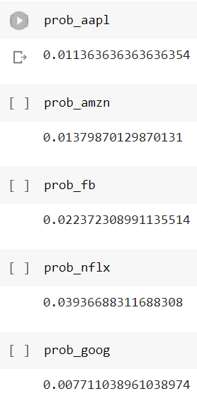
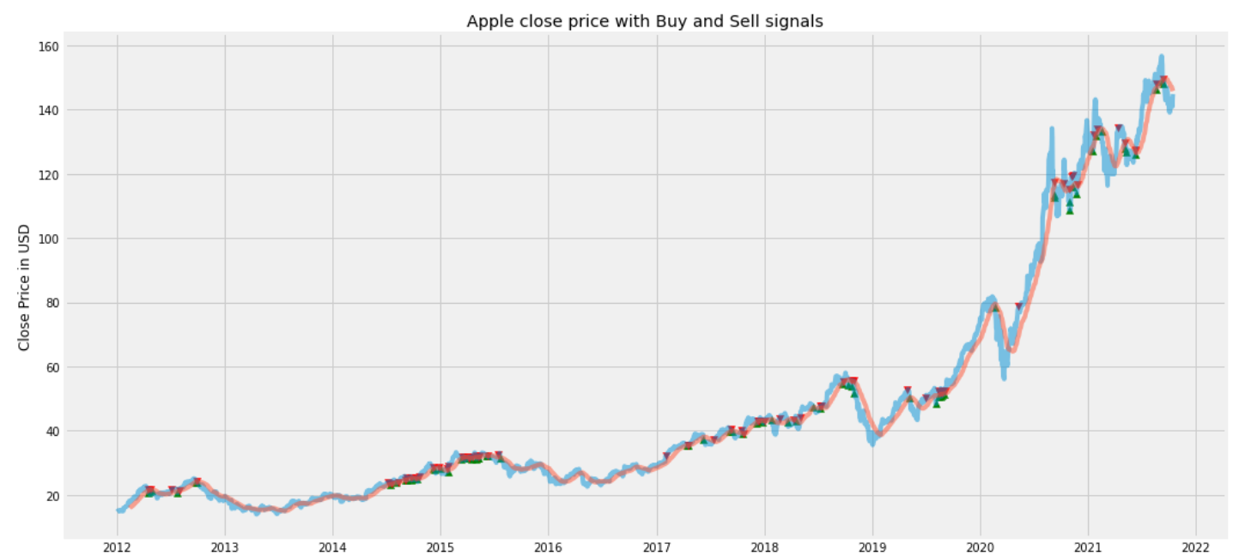
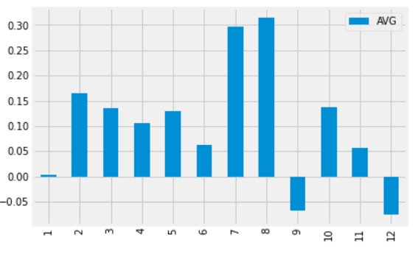
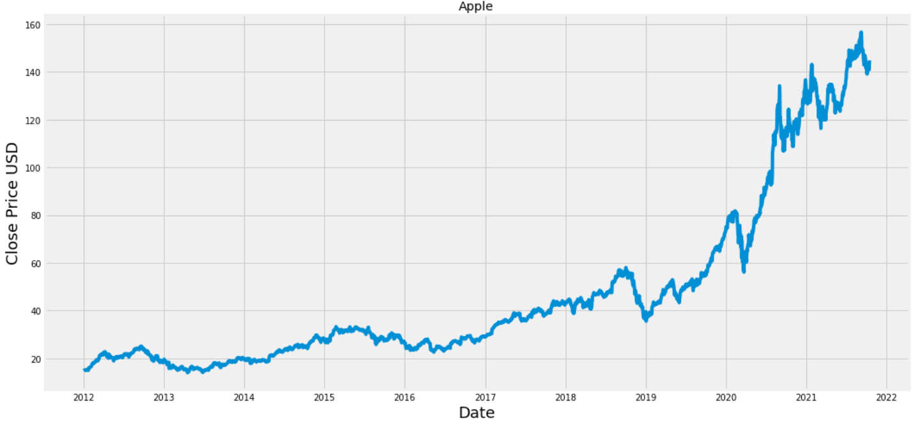
STOCK BOT – A MATHEMATICAL STOCK RECOMMENDATION PROGRAM
OUTPUTS:

